Slide 1

Reinforcement Learning based Driving Strategies
For Autonomous Driving Systems
Presented by
Harshit Soora
17CS10014
BTech CSE IITKGP
Guided by Prof. Pallab Dasgupta
Dept of Computer Science & Engineering
Indian Institute of Technology Kharagpur

Slide 2
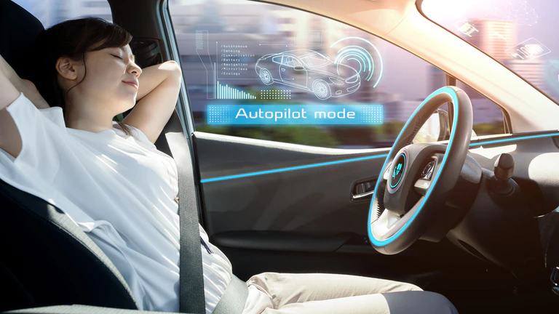
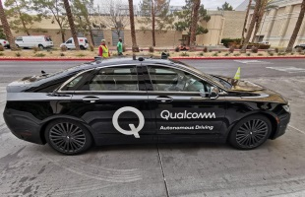
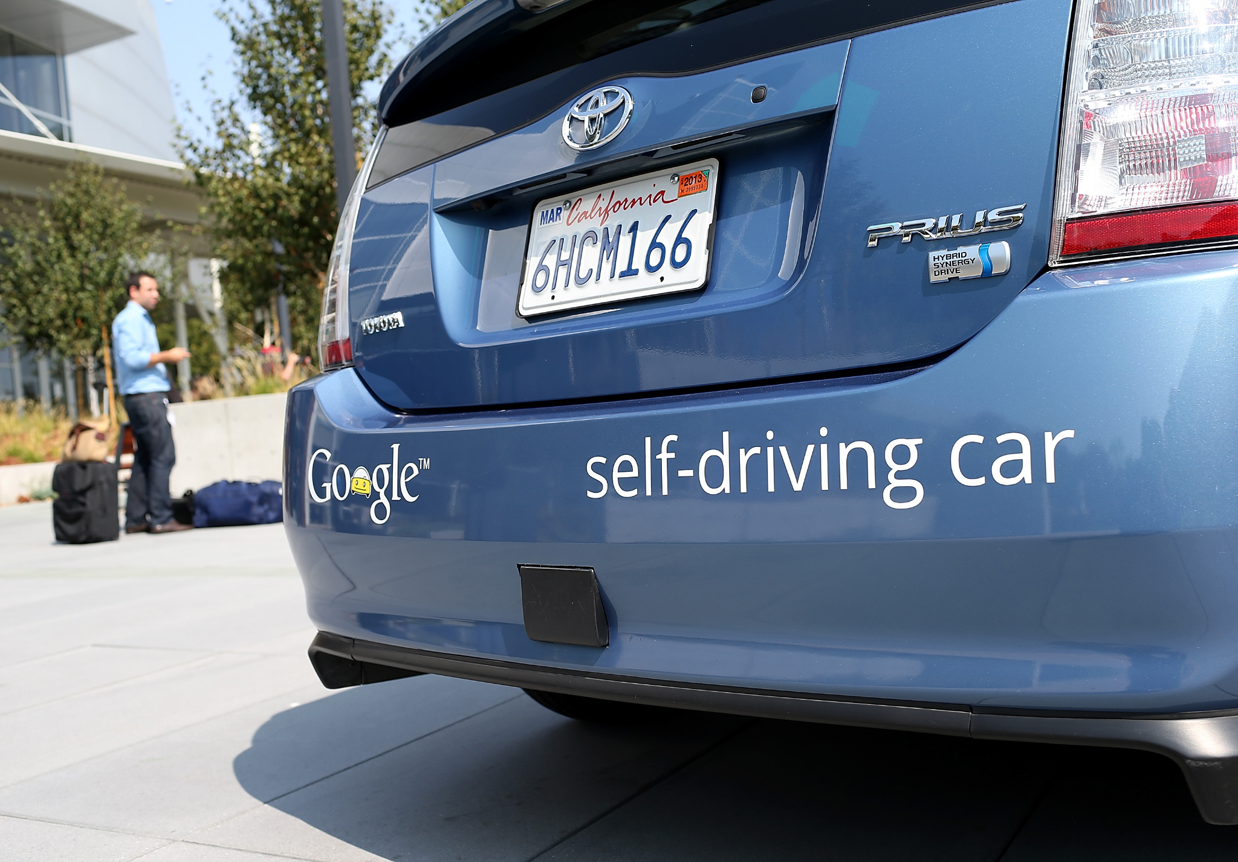
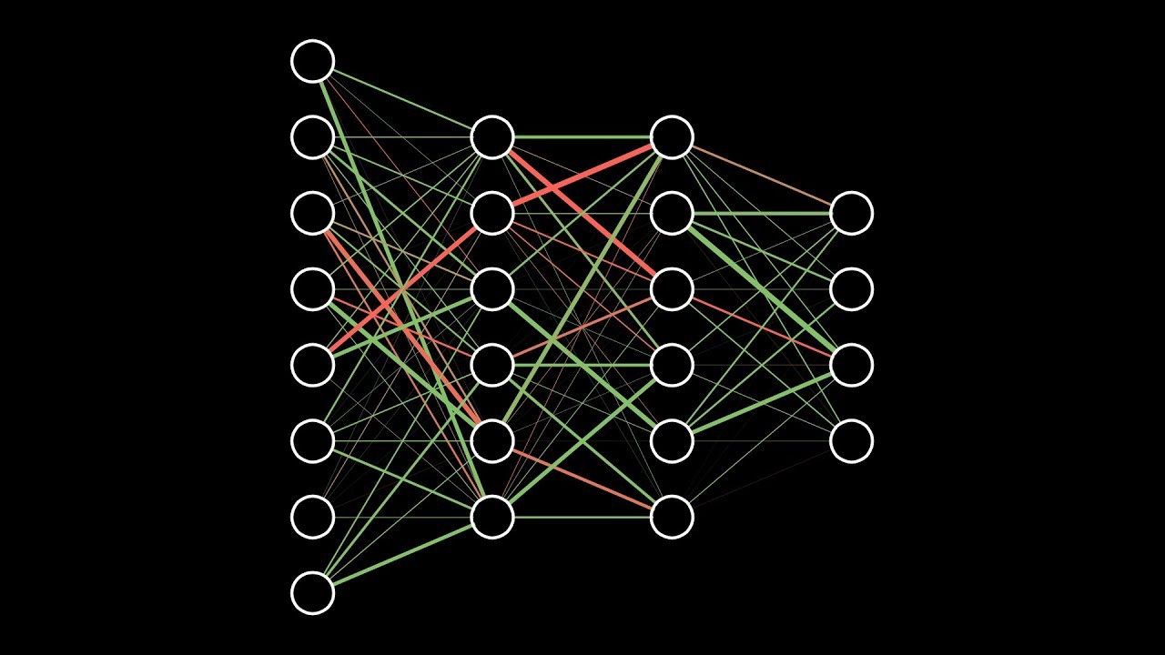
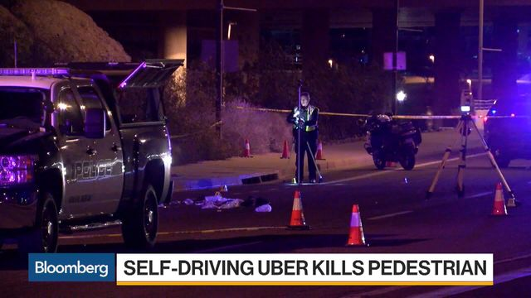
INTRODUCTION
Industrial Autonomous Driving race have big players like Tesla, Google, Qualcomm, Nvidia
Boon or Bane
Deep RL : Large State Space, lots of action to explore and millions of hyperparameter
to train
Notes:
Two Sides of Coin

Slide 3
PROBLEM FORMULATION
Given a Reinforcement learning agent (R), a problem in continuous Markov decision process environment(E), this project involves developing a toolchain consisting of three maneuvers keeping in mind different driving strategies and modelling them in Carla software for different road situations.
R is our ego vehicle, E is everything outside the ego vehicle.
Maneuvers are Straight Drive, Turning Model and Lane Change.
Challenges
Complex State and Action Space
Safety Assurance of Behaviour
Solution
Break down into maneuvers
Reinforcement Learning Policies like DDPG

Slide 4
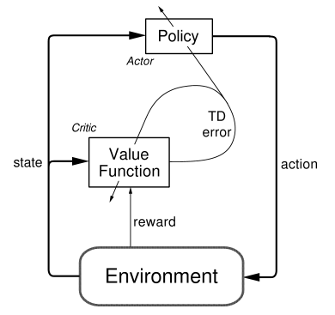
LITERATURE STUDY : DDPG
^{Actor}
^{Learns Policy}
Objective function is to increase the probability of actions that lead to better reward
^{Two Network}
Training Network to train on environment
Target Network is slowly converged to training, used for prediction
^{Critic}
^{Learns Value Function}
Objective function is to reduce the Mean Squared Error

Slide 5
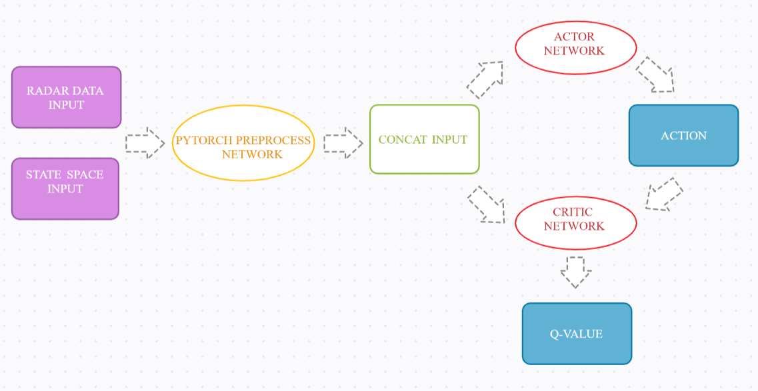
EXPERIMENTAL NEURAL NETWORK

Slide 6
MANEUVER 1 : STRAIGHT DRIVE
Actor Critic RL
Preprocess Layer
5 layer feed forward network of radar
I/P [500] -- 512 -- 256 -- 128 -- 64
3 layer feed forward network for state
I/P [1] -- 4 -- 16
3 layer feed forward network for action
I/P [1] -- 4 -- 16
Value Network (Actor)
4 layer feed forward network
I/P layer concate of radar and state
Hidden layer dim = 64 & 32
O/P layer dim = 1 [Action]
Policy Network (Critic)
4 layer feed forward network
I/P layer concate of radar and state and action
Hidden layer dim = 64 & 32
O/P layer dim = 1 [Q Value]
^{State}
^{Odometer}
^{Radar Data Point (500)}
^{Actions}
^{Throttle value 0.0 - 1.0}
^{Activation Function}
^{Tanh}

Slide 7
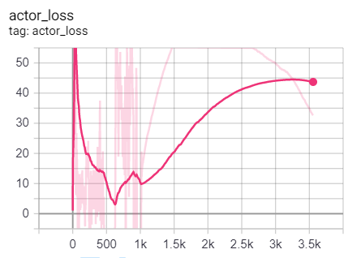
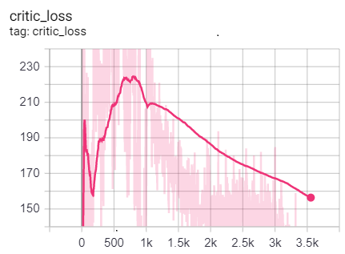
MANEUVER 1 : RESULTS

Slide 8
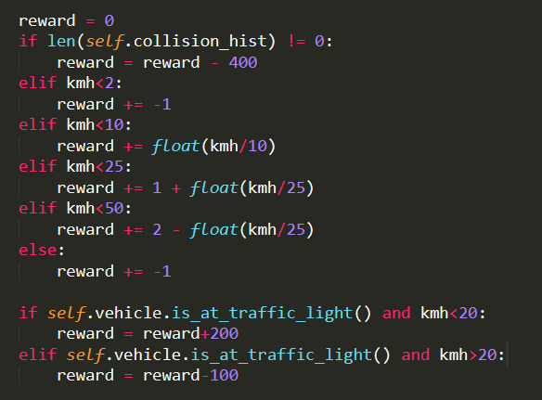
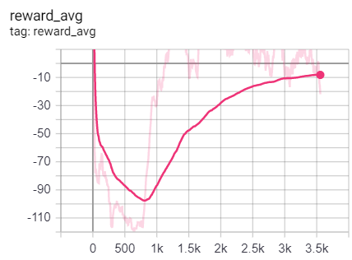
MANEUVER 1 : RESULTS

Slide 9
MANEUVER 2 : RIGHT TURN
Actor Critic RL
Preprocess Layer
5 layer feed forward network of radar
I/P [400] -- 512 -- 256 -- 128 -- 64
3 layer feed forward network for state
I/P [1] -- 8 -- 32
3 layer feed forward network for action
I/P [1] -- 4 -- 16
Value Network (Actor)
4 layer feed forward network
I/P layer concate of radar and state
Hidden layer dim = 64 & 32
O/P layer dim = 1 [Action]
Policy Network (Critic)
4 layer feed forward network
I/P layer concate of radar and state and action
Hidden layer dim = 64 & 32
O/P layer dim = 1 [Q Value]
^{State}
^{Norm from Target, Diff Angle}
^{Radar Data Point (400)}
^{Actions}
^{Throttle value 0.5}
^{Turn value 0.0 - 1.0}
^{Activation Function}
^{Tanh}

Slide 10
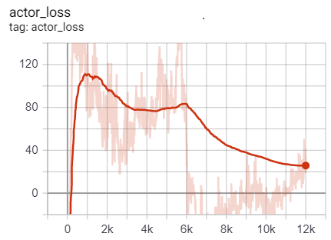
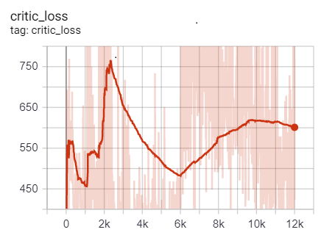
MANEUVER 2 : RESULTS

Slide 11
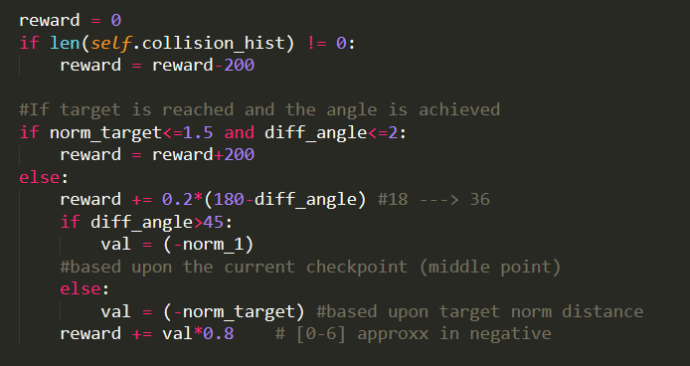
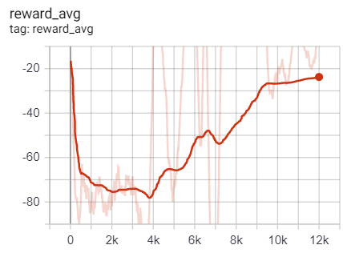
MANEUVER 2 : RESULTS

Slide 12
MANEUVER 2 : LANE CHANGE
Actor Critic RL
Preprocess Layer
5 layer feed forward network of radar
I/P [500] -- 512 -- 256 -- 128 -- 64
3 layer feed forward network for state
I/P [1] -- 8 -- 32
3 layer feed forward network for action
I/P [1] -- 4 -- 16
Value Network (Actor)
4 layer feed forward network
I/P layer concate of radar and state
Hidden layer dim = 64 & 32
O/P layer dim = 1 [Action]
Policy Network (Critic)
4 layer feed forward network
I/P layer concate of radar and state and action
Hidden layer dim = 64 & 32
O/P layer dim = 1 [Q Value]
^{State}
^{Norm from Target, Diff Angle}
^{Radar Data Point (500)}
^{Actions}
^{Throttle value 0.5}
^{Turn value -1.0 to 1.0}
^{Activation Function}
^{Tanh}

Slide 13
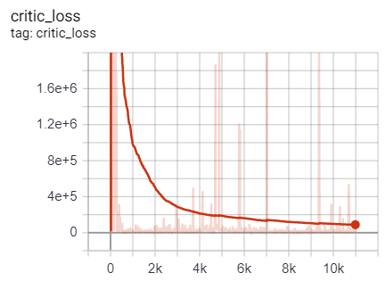
MANEUVER 3 : RESULTS

Slide 14
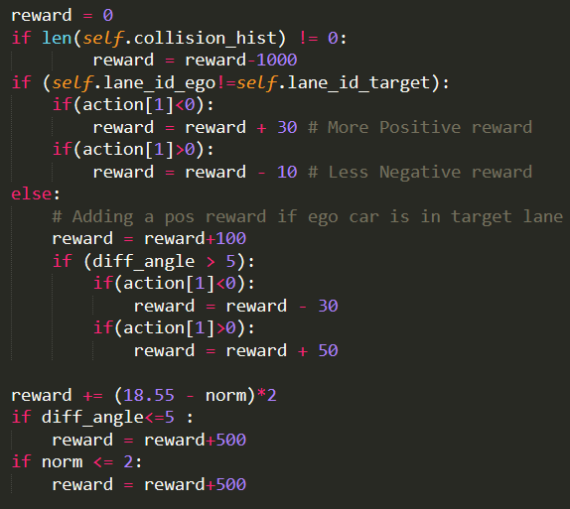
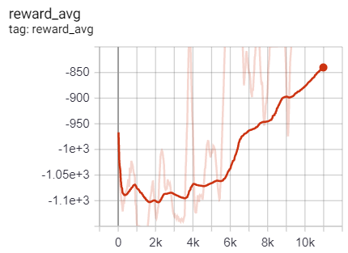
MANEUVER 3 : RESULTS

Slide 15
ADDITION EXPERIMENTAL OBSERVATION- I
^{Turning Maneuver}
^{Double Check Point}
^{Vs.}
^{Single Check Point}
^{PROBLEMS}
Ego Vehicle don’t have the freedom to take reverse turn
Ego Vehicle can’t slow its throttle value, constant at 0.5
Ego Vehicle can’t even apply break
Sharp Turn Can take a roundabout across the start point
Long Turn Can go into the opposite lane
^{Solution Single Check Point}

Slide 16
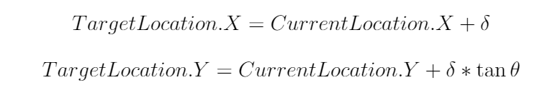
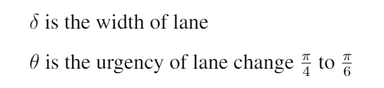
ADDITION EXPERIMENTAL OBSERVATION- II
^{Lane Change Maneuver}
^{Innovative}
^{Norm}
^{Distance}
Urgency could be learned with different Reinforcement Learning Module
^{More Robust State Space}

Slide 17
FUTURE SCOPE
^{Optimal Radar Points}
Convergence vs. Complexity Tradeoff
^{500-600 : Most Optimal Range}
^{Checkpointing}
^{Problem}
^{Turning Maneuver}
^{Desired Arc Maneuver}
^{Optimal Reward Model}
^{Inverse Reinforcement Learning}
^{Learning from Failures}

Slide 18
KEY TAKEAWAY POINT
^{Actor Loss Plot}
^{Decrease Gradient Descend}
^{Increase Exploration Epsilon}
^{Optimal Radar Points}
Negative Reward vs. Positive Reward
^{Continuous vs. Sparse Reward}

Slide 19
REFERENCES
[1] V. Mnih, K. Kavukcuoglu, D. Silver, A. Graves, I. Antonoglou, D. Wierstra, and M. Riedmiller, “Playing atari with deep reinforcement learning,” 2013.
[2] T. P. Lillicrap, J. J. Hunt, A. Pritzel, N. Heess, T. Erez, Y. Tassa, D. Silver, and D. Wierstra, “Continuous control with deep reinforcement learning,” 2019.
[3] V. Mnih, A. P. Badia, M. Mirza, A. Graves, T. P. Lillicrap, T. Harley, D. Silver, and K. Kavukcuoglu, “Asynchronous methods for deep rein. learning,” 2016.
[4] A. Kendall, J. Hawke, D. Janz, P. Mazur, D. Reda, J.-M. Allen, V.-D. Lam, A. Bewley, and A. Shah, “Learning to drive in a day,” 2018.
[5] C. Team, “Carla release 0.9.8 [reference link],” https://carla.org/2020/03/09/release-0.9.8/.

Slide 20
REFERENCES
[6] H. Soora, “Safe strategies for autonomous driving systems (code distribution) [available on github],” https://github.com/harshit-soora/Carla-DDPG.
[7] B. Gangopadhyay, “Hierarchical-program-triggered-rl (code distribution),”
https://github.com/britig/Hierarchical-Program-Triggered-RL.
[8] Sentdex, “Programming autonomous self-driving cars with carla and python [available on youtube],” https://www.youtube.com/watch?v=J1F32aVSYaU&t=1252s&abchannel=sentdex.
[9] A. Y. Ng and S. Russell, “Algorithms for inverse reinforcement learning,” pp.663–670, 2000.

Slide 21
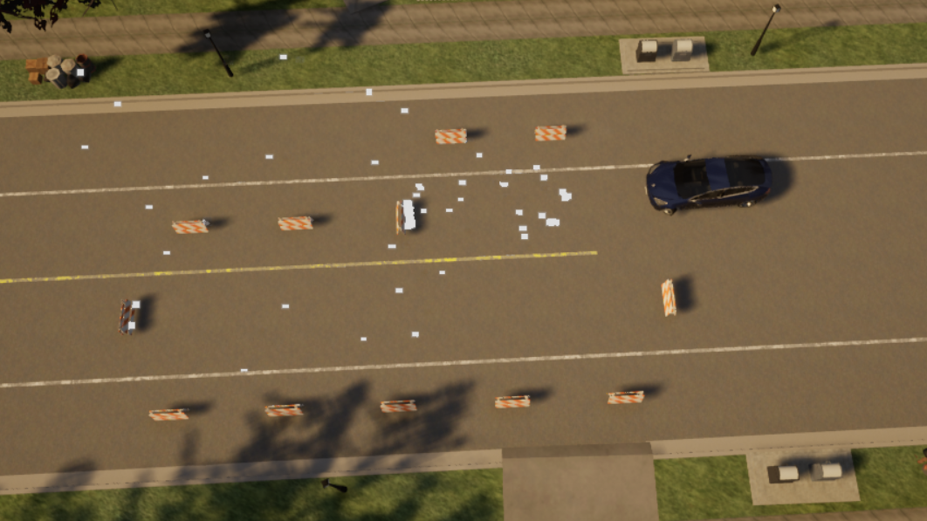
THANK YOU

